Slide 1
Program
MineOperate Technical Level 1
OP Pro Servers TL1
Edgar Sepulveda
Global Technical Manager, MineOperate
10/10/2022
Version 1.3

Slide 2

Purpose
This training provides information for Hexagon engineers to install and setup MineOperate OP Pro software on application servers.
At the end of this module, you will:
Be able to install OP Pro applications server.
Setup JAMSCluster.
Setup data replication.
​

Slide 3
System Overview
A typical OP Pro Fleet Management System (FMS) is composed of the following:
Active OP Pro server
Ubuntu server running the OP Pro FMS software
Backup OP Pro server
Ubuntu server running as a backup
Reporting server
Microsoft SQL server that provides a reporting database
Field equipment
Installed with Hexagon Mining hardware and software that connects to the active OP Pro server
OP Pro Manager clients running on PCs in the customer's corporate network

Slide 4
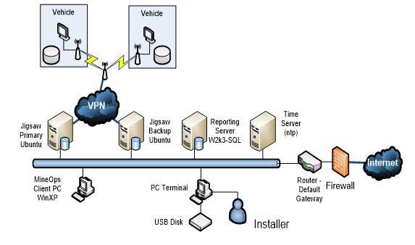
System Overview

Slide 5
JAMS Cluster
Two OP Pro servers are typically deployed as a cluster (JAMS Cluster)
One server runs as the active server which runs the OP Pro software. All field equipment and OP Pro Manager clients connect to the active server.
One server runs as the backup server which replicates data from
Database on the active server to the database on the backup server
Database on the active server to the database on the reporting server
The servers share a floating IP address where all field equipment and OP Pro Manager clients connect to.
If the servers are failed over, the backup server will change roles to the active server and vice versa. The new active server will take the floating IP address.

Slide 6
Server Requirements
Before commissioning OP Pro servers, ensure that the servers have sufficient resources.
This is documented in the relevant I.T systems requirement documentation.
https://confluence.hexagonmining.com/display/MPub/MIN+Operations+Systems+Technical+Requirements

Slide 7
Installation Manual
The instructions on how to install OP Pro software and related services can be found in the installation manual located in SharePoint:
https://hexmet.sharepoint.com/:w:/r/sites/APACServicesSupport/Shared%20Documents/00%20-%20Services/01%20-%20Products/01%20-%20MineOperate/01%20-%20OP%20Pro/01%20-%20MineOperate%20OP%20Pro%20Deployment/Jigsaw_Server_IM_Ubuntu_16.04.docx?d=w9f729a41ab8d4c09a3e8287db42a0540&csf=1&web=1&e=5oIFKF

Slide 8
Install OS and applications
Ubuntu Operating system.
PostgreSQL Relational database system.
OpenSSH Tool for remote login with the SSH protocol.
Samba Standard Windows interoperability suite of programs for Linux and Unix.
rsync Provides fast incremental file transfer.
NTP Networking protocol for clock synchronization between computers.
nginx HTTP and reverse proxy server, a mail proxy server, and a generic TCP/UDP proxy server.
sqsh Interactive SQL client.

Slide 9
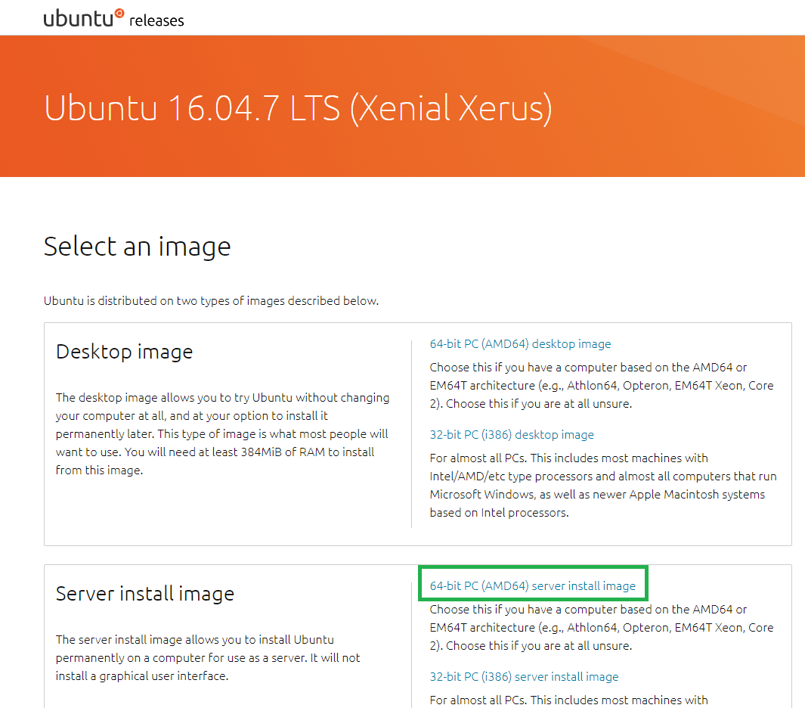
Install Ubuntu
To commission an OP Pro server, the Operating System must first be installed.
This can be performed by Hexagon or the customer
Follow the installation instructions as per the installation manual
Link to download Ubuntu 16.04 iso
https://releases.ubuntu.com/16.04/
Download 64-bit PC (AMD64) server install image

Slide 10
Install Ubuntu
These applications can be installed during Ubuntu installation process:
PostgreSQL
OpenSSH
Samba
You can set them up after Ubuntu installation is complete.

Slide 11
Setup Server Environment
After Ubuntu is installed, the environment needs to be setup
Setup jigsaw and root users and passwords
Setup jigsaw user profile and environment variables
Update /etc/hosts with peer OP Pro server (if running a cluster) and field equipment
Install services and libraries
Setup /etc/rc.local so that services automatically start on boot up

Slide 12
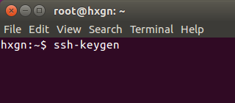
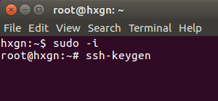
Setup OpenSSH
ssh is the prefer Hexagon connection to server
Set up authorized_keys
Configure reverse ssh connection

Slide 13
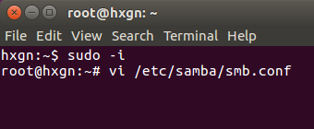
Setup Samba
Samba is used to share files on the OP Pro Ubuntu servers with Windows users
Samba is used for:
Copying HP design files to the relevant machine folders on the OP Pro server
Copying CSV files onto the OP Pro server to import various items into OP Pro (locations, drill patterns etc.)
Copying OP Pro Manager installer from the OP Pro server
Copying equipment flash key files from the OP Pro server

Slide 14
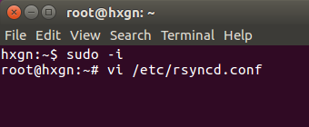
Setup rsync
Rsync is used to transfer files between OP Pro servers
Key system files that need to be kept in sync (e.g. Software releases, OpenVPN equipment keys etc.)
Also used to synchronize files between the active OP Pro server and field equipment
Software updates
HP design files
As-built files
Installed as part of Operating System installation

Slide 15
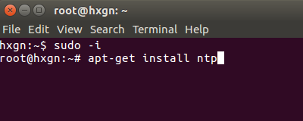
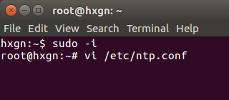
Setup NTP
NTP will be used to synchronize the time on the OP Pro servers.
Can be a server at site or a server on the Internet (providing the customer allows a connection to the Internet).
Use apt-get command to install NTP
Set up ntp config file

Slide 16
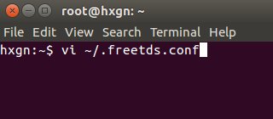
Setup Replication
Set password
/etc/hosts
Install services and libraries
Libssl
Libreadline
Trim scripts
freetds
Services and libraries can be installed using the apt-get install command

Slide 17
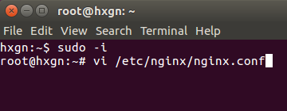
Setup nginx
Nginx can be installed using apt-get install command
Set up nginx config file

Slide 18
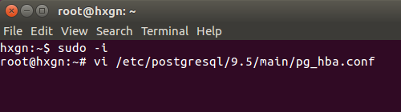
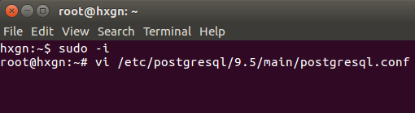
Setup PostgreSQL and database
Set access permissions
Setup user
Postgres optimization
Install extension and views
Rake migrate

Slide 19
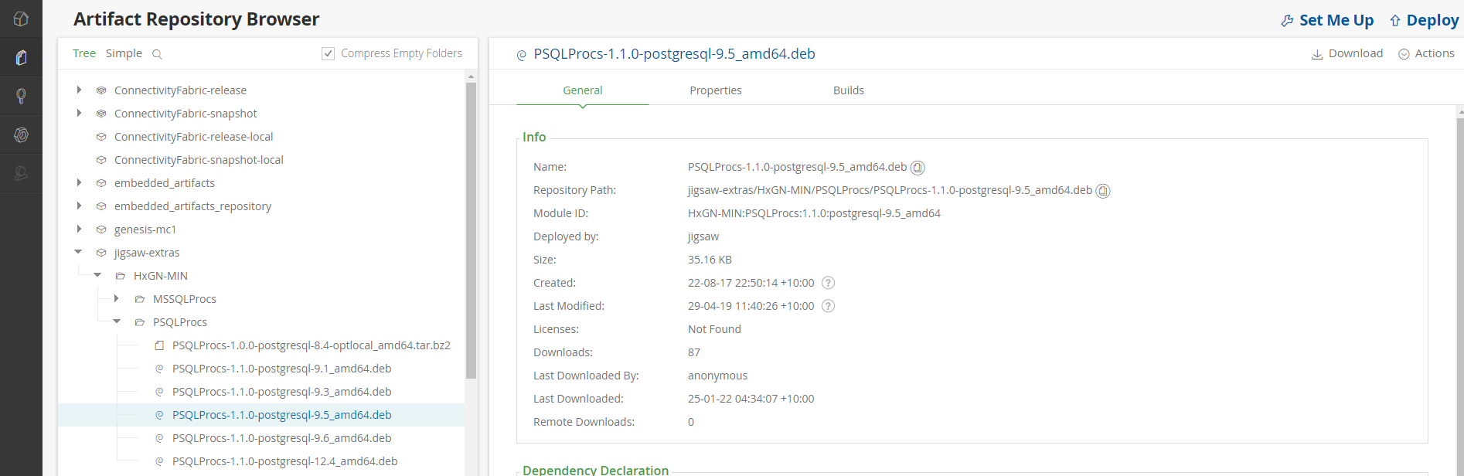
Setup PostgreSQL
Install PSQLProcs
Link to download PSQLProcs
http://10.76.9.64:8081/artifactory/webapp/#/artifacts/browse/tree/General/jigsaw-extras/HxGN-MIN/PSQLProcs

Slide 20
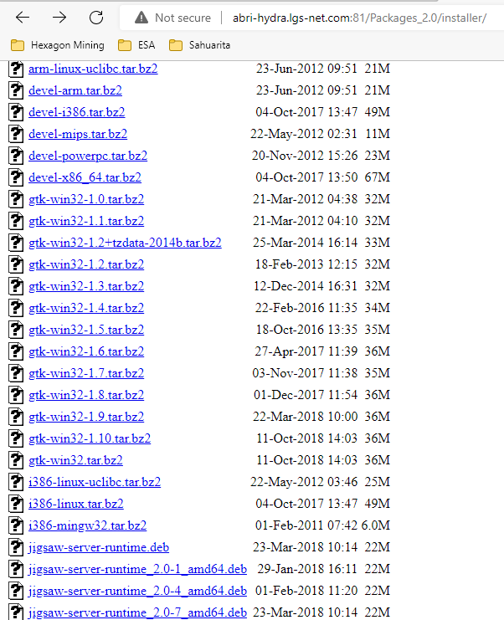
Install JAMS
JAMSCluster
JAMSGateway
Link to download OP Pro application server libraries
http://abri-hydra.lgs-net.com:81/Packages_2.0/installer/

Slide 21
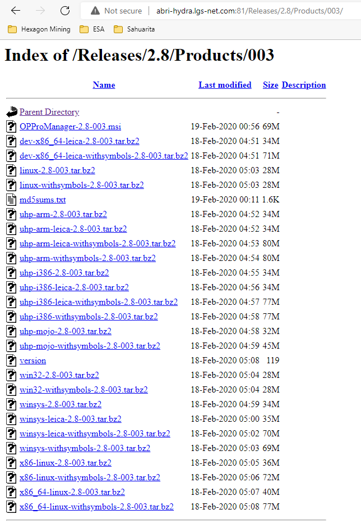
Install JAMS
Link to download OP Pro software
http://abri-hydra.lgs-net.com:81/Releases/2.8/Products/003/

Slide 22
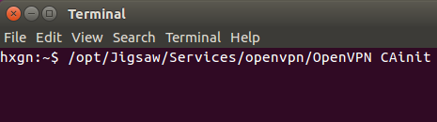
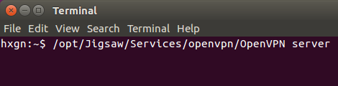
Setup OpenVPN
Initialize Certificate Authority
Set up vpnserver.conf file

Slide 23
Setup OpenVPN
Create config.sqfs and setup.sqfs files
Make clients
/opt/Jigsaw/Services/openvpn/OpenVPN makeclients
Create keys
for i in `ls /opt/Jigsaw/Clients/client/openvpn/clients`;do /opt/Jigsaw/Services/openvpn/OpenVPN key $i; done;
Write keys
/opt/Jigsaw/Services/openvpn/OpenVPN writekeys

Slide 24
OP Pro Servers TL1 - Questions
True or False Three servers are requiered to run OP Pro Fleet Management System.
True or False JAMSCluster active server takes the floating IP address where all field equipment and OP Pro Manager clients connect to.
What applications can be installed during Ubuntu installation process:
PostgreSQL
NTP
Samba
Nginx
All above
True or False /opt/Jigsaw/Services/openvpn/OpenVPN CAinit command creates vpnserver.conf file.
True or False Make clients, Create keys and Write keys are the three steps to create setup.sqfs and config.sqfs

Slide 25
OP Pro Servers TL1 - Answers to Questions
True or False Three servers are requiered to run OP Pro Fleet Management System. True
True or False JAMSCluster active server takes the floating IP address where all field equipment and OP Pro Manager clients connect to. True
What applications can be installed during Ubuntu installation process:
PostgreSQL
NTP
Samba
Nginx
All above
True or False /opt/Jigsaw/Services/openvpn/OpenVPN CAinit command creates vpnserver.conf file. False
True or False Make clients, Create keys and Write keys are the three steps to create setup.sqfs and config.sqfs True

Slide 26

THANK
Y
O
U

